Slide 1

Smart Shopping Cart System
Revolutionizing the retail experience with RFID technology.

Slide 2
Agenda
System Overview: RFID-based item management
Adding and Removing Items: Streamlined process
Billing and Checkout: Automated finalization
Technical Considerations: Bluetooth module alternative

Slide 3



RFID-Based Item Management
Our system utilizes 3-4 RFID tags, each representing a different item, to track products in the shopping cart.
Item Tags
RFID Reader
Customer Log
Each product has a unique RFID tag.
A module in the cart scans tags.
Items are added to a digital log.

Slide 4
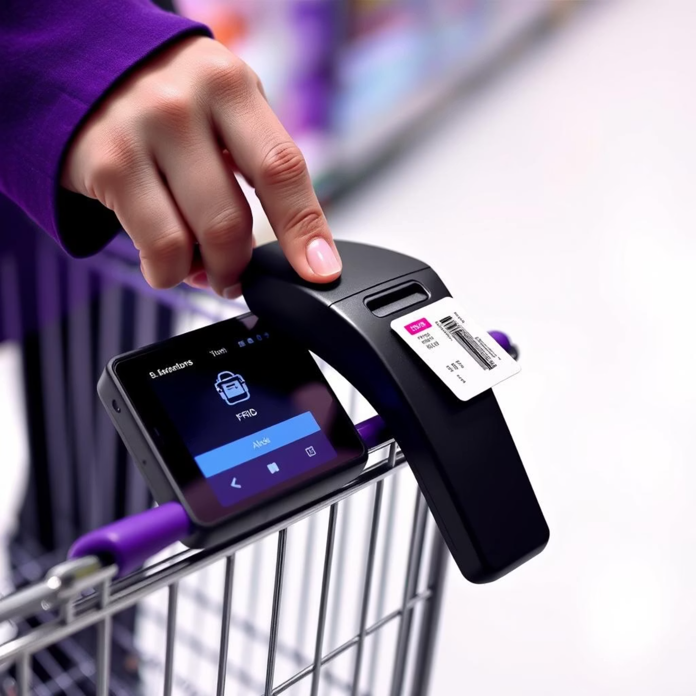
Adding Items to Cart
To add an item, simply tap its RFID tag on the reader module.
Once scanned, place the item in the cart, and it will be automatically added to the customer's digital log.

Slide 5
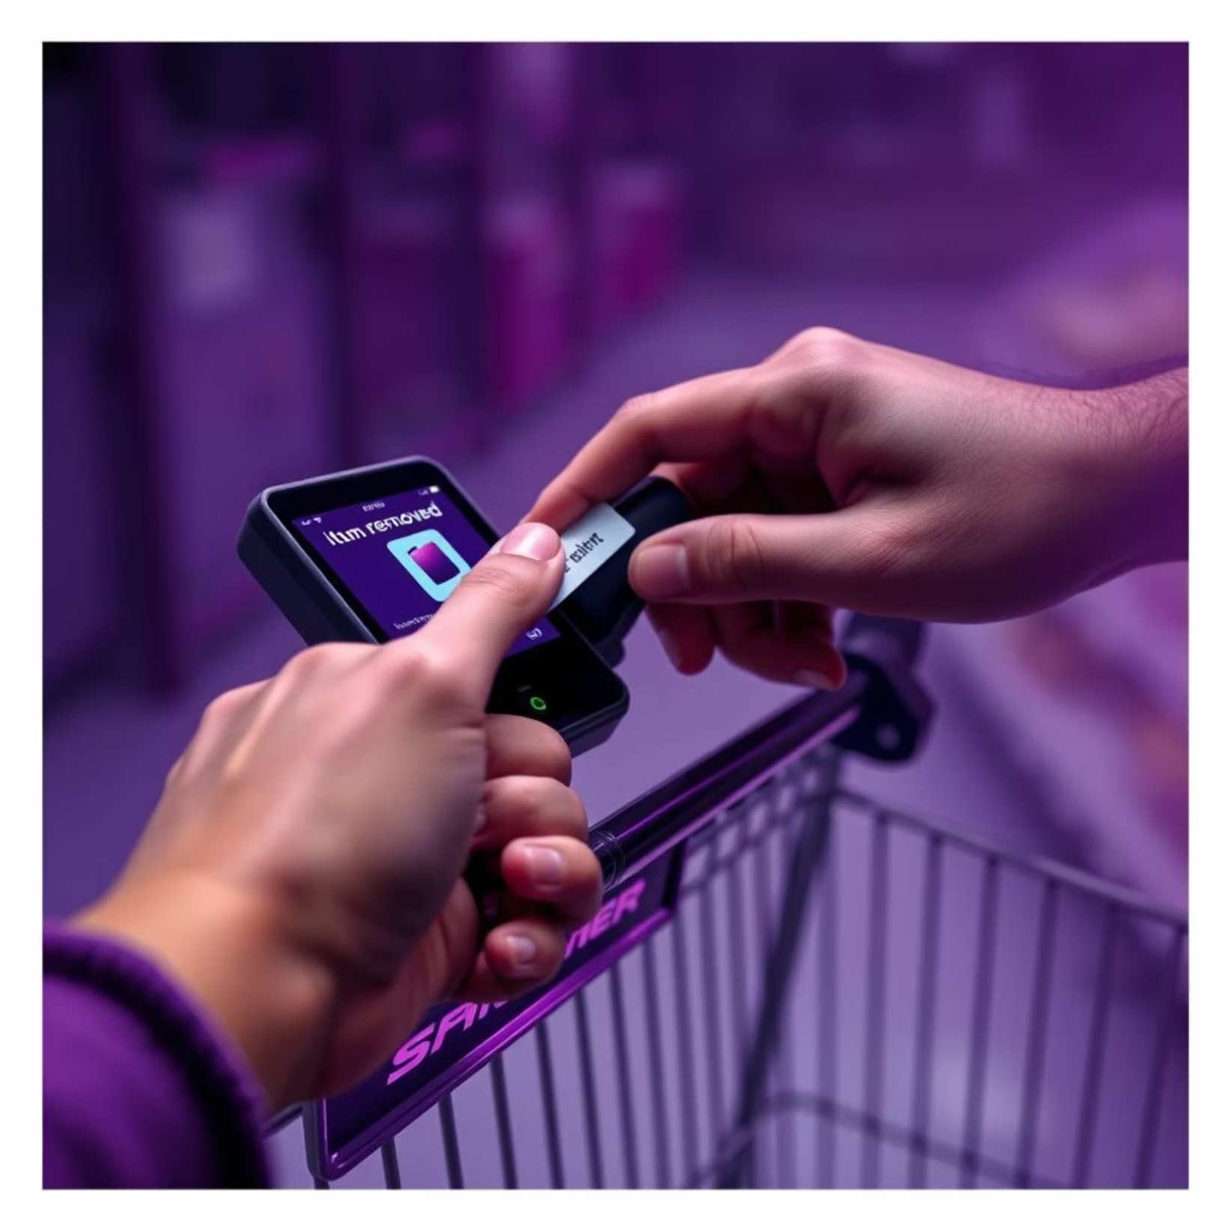
Removing Items from Cart
If a customer wishes to remove an item, they must tap its RFID tag on the reader module again.
This action will automatically remove the item from their customer log.

Slide 6



Automated Billing and Checkout
Once shopping is complete, the customer uses a dedicated "shopping card" to finalize their purchase.
Shopping Card
Tap to Close
Bill Generated
A separate RFID card for billing.
Tap the card on the reader to finalize the bill.
Automated bill based on customer log.

Slide 7
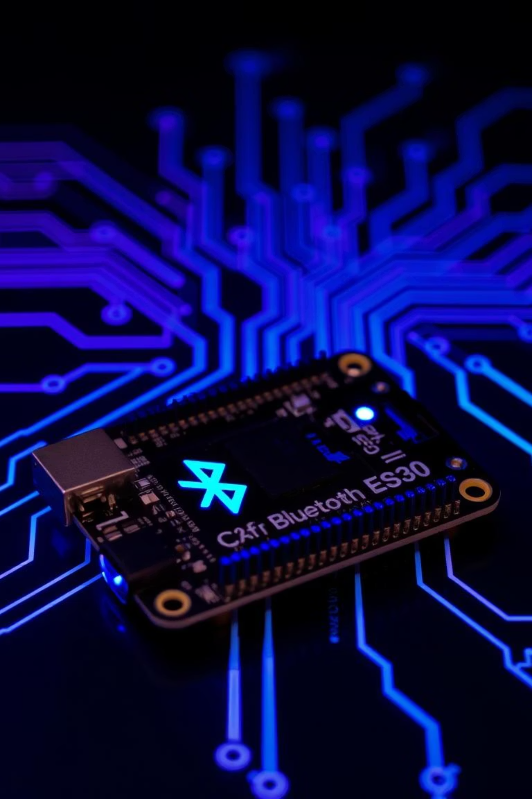

Technical Considerations
We have a contingency plan for potential issues with the L298 module.
Bluetooth Module Alternative
The code can be modified to utilize the ESP32's built-in Bluetooth module.
This would allow for communication via "Serial Bluetooth Terminal by Kai Morich" if needed.

Slide 8
Key Takeaways & Next Steps
RFID tags enable seamless item tracking.
Automated add/remove and billing processes.
Bluetooth module provides a robust alternative for communication.
Further testing and refinement of the system.

